Slide 1
The Nervous System
Adapted from Scott Hatfield, Biology, Bullard High School

Slide 2
The Nervous System
like the conductor of an orchestra
controls and coordinates body functions
responds to internal and external stimuli
mostly made of cells called neurons

Slide 3
TYPES OF NEURONS:
Sensory neurons: carry impulses from the sense organs to the spinal cord and brain
Motor neurons: carry impulses from the brain and spinal cord to the muscles and glands
Interneurons: Connect sensory and motor neurons

Slide 4
Neuron
Structure:
The cell body (soma) contains the nucleus, organelles and most of the cytoplasm

Slide 5
Neuron
Structure:
Projections called dendrites, receive impulses from the environment, or from other neurons

Slide 6
Neuron
Structure:
The impulses are carried away from the soma by a long fiber (the axon )
This extension ends in swellings called axon terminals

Slide 7
Neuron
Structure:
The axon is often partially insulated by a layer of protein called the myelin sheath
gaps in the sheath are known as the nodes of Ranvier

Slide 8
The Synapse:
Neurons are not physically connected to each other: instead, there is a tiny gap, called the synapse

Slide 9
The Synapse:
The nerve impulse arrives at the end of one neuron (the axon terminal)
This triggers the release of chemicals (neurotransmitters)

Slide 10
The Synapse:
The chemicals cross the synapse, and are detected by receptors on the dendrite of another neuron
If the chemicals ‘excite’ this neuron, this will trigger a new nerve impulse….!

Slide 11
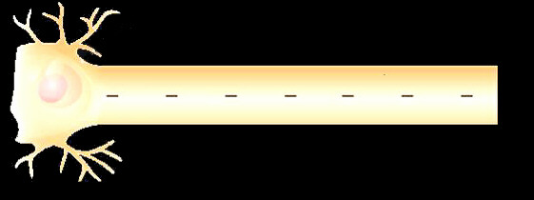
The Action Potential
How are messages (impulses) carried by the nervous system?
As electrical and chemical signals.
How does the impulse develop?
The nerve cell is stimulated
Charged sodium and potassium ions move across the cell membrane

Slide 12
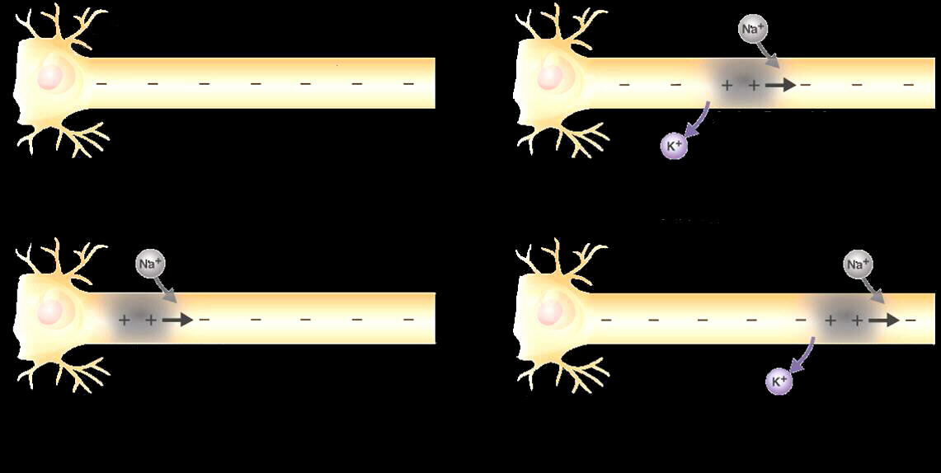
The Action Potential

Slide 13
Divisions of the Nervous System

Slide 14
Central Nervous System (CNS)
relays, processes, and analyzes information
brain and spinal cord

Slide 15
The Brain
where impulses originate
four major parts of the brain:
cerebrum
cerebellum
Brain stem
thalamus and hypothalamus

Slide 16
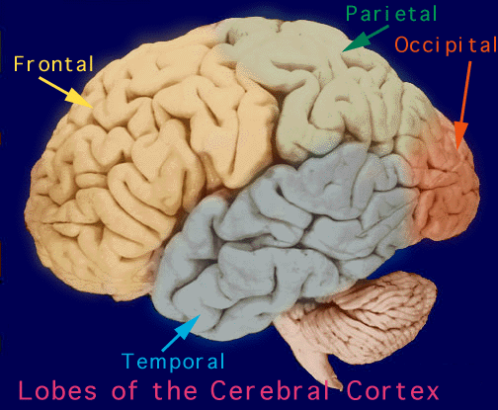
Cerebrum:
Largest and most prominent part, responsible for conscious activities of body

Slide 17
Cerebrum is divided into:
Left Hemisphere
controls body’s right side
associated with analytical and mathematical ability
Right Hemisphere
controls body’s left side
creativity, artistic ability

Slide 18
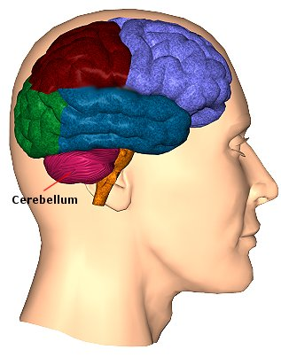
Cerebellum
second largest region of the brain
at the back of the skull
coordinates and balances the actions of muscles

Slide 19
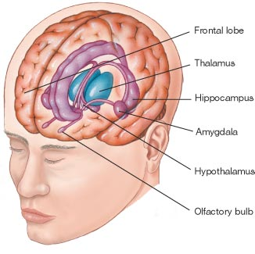
Thalamus
receives messages from all of the sensory receptors
Hypothalamus
controls recognition
involves feelings of hunger, thirst, fatigue, anger and body temperature.

Slide 20
Brain Stem
connects brain and spinal cord

Slide 21
The Spinal Cord
main communication link between the brain and the rest of the body 1
Controls automatic response to a stimulus

Slide 22
:
..consists of all the neurons and associated cells which are not part of the brain or
the spinal cord

Slide 23
The Peripheral Nervous System:
…contains a sensory and motor division

Slide 24
The sensory division transmits impulses to the CNS

Slide 25
The motor division is further divided into the somatic and autonomic nervous systems

Slide 26
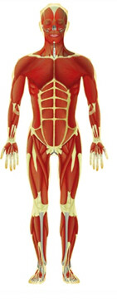
Somatic Nervous System:
regulates activities that are under conscious control, such as skeletal muscles

Slide 27
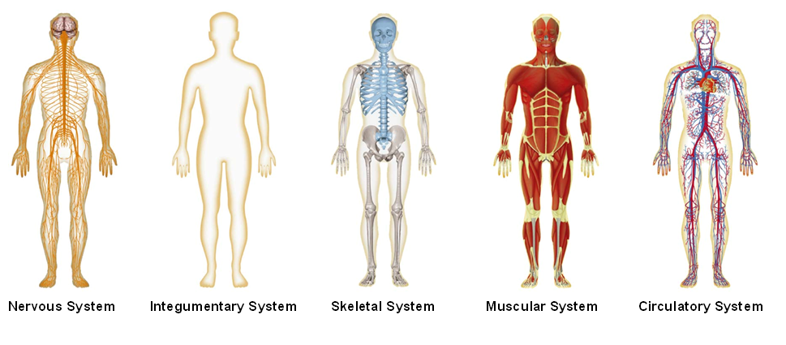
Autonomic Nervous System:
regulates activities that are involuntary, influences body systems to work together, ‘in concert’!

Slide 28
The ENDOCRINE System:
releases and monitors the levels of chemical ‘messengers’ called hormones
can be thought of as the ‘slow message’ system, that works with the ‘fast messages’ of the nervous system
involved in growth, reproduction and in maintaining homeostasis

