Slide 1
CLIMATE Key question #10
What is the difference between climate and weather?
How do we pictorially represent climate over a year?

Slide 2
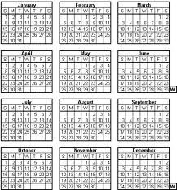
CLIMATE
CLIMATE IS OVER TIME (Like one or more years)
NOT IN A DAY
Weather is in a day or a few days

Slide 3
What tells you about CLIMATE?
Rainfall - precipitation
Averages over a year, for many years
What months have a lot of rain, a little?
Temperature
Averages over a year, for many years
What is the average temperature by the month?
Is it hot or cold in July usually? October?

Slide 4
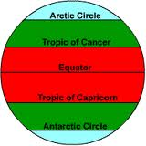
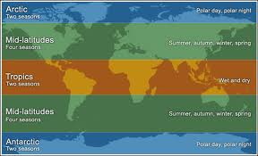
CLIMATE ZONES
Tropical is near the equator
Temperate is half way to poles
Polar is the area near the poles

Slide 5
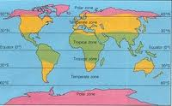
CLIMATE ZONES
North polar
North temperate
Tropical
South temperate
South polar

Slide 6
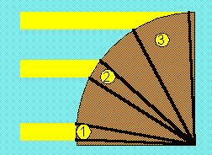
WHY ARE THE ZONES DIFFERENT?
TROPICS GET THE MOST SUN. They are hot year round
TEMPERATE ZONES get medium amount of sun. They cycle between hot and cold
POLAR ZONES get the least sun. They are cold most of the time

Slide 7
Why do different areas have different amount of heat?
Compare area #1 to area #3. Notice in area #3 the given amount of light (and heat) is spread over a larger area, so the energy is less concentrated.

Slide 8
Seasons in the Northern Hemisphere
WINTER
January, February March
SPRING
April, May June
SUMMER
July, August, Sept
AUTUMN OR FALL
October, November, December

Slide 9
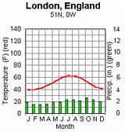
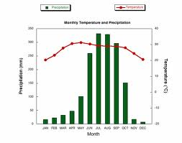
CLIMATOGRAMS
Show climate patterns for a biome over a YEAR
Left side is rainfall (precipitation). Shown as a bar graph
Right side is temperature. Shown as a line graph

Slide 10
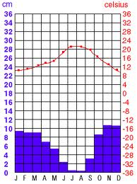
Describe the climate (rainfall and temperature by the season)
75
68
60
53

Slide 11
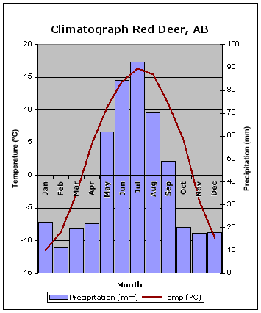
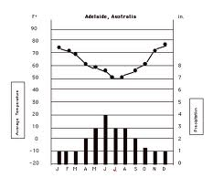
1. Describe the rain and temp by the season 2. Identify where in the world you think it might be

